Slide 1
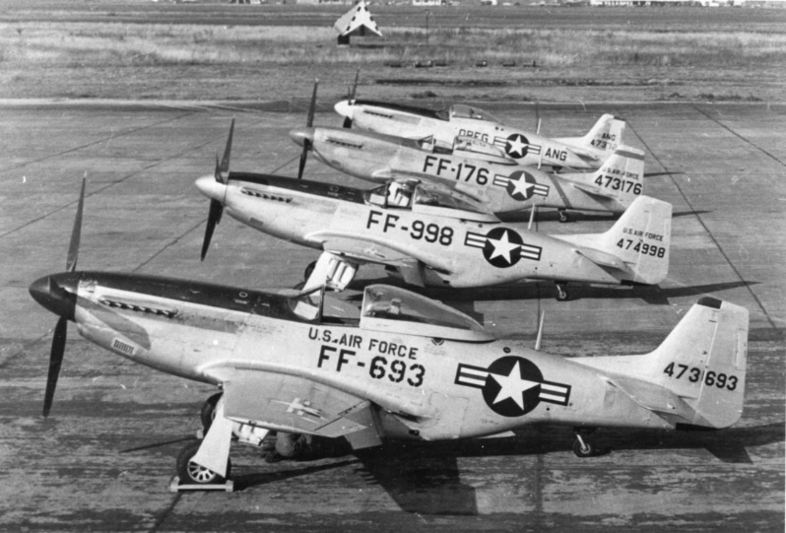

Slide 2
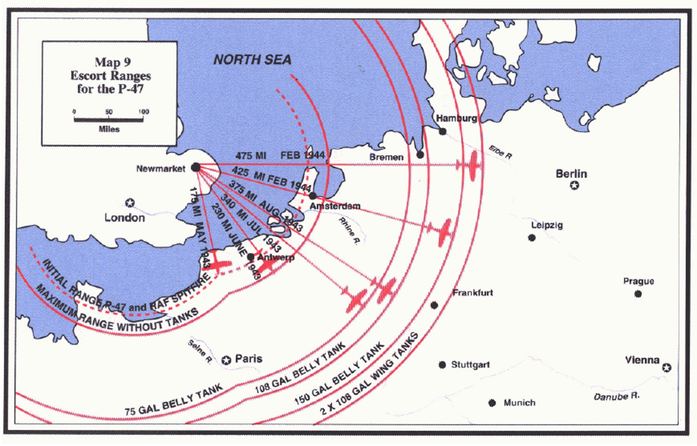
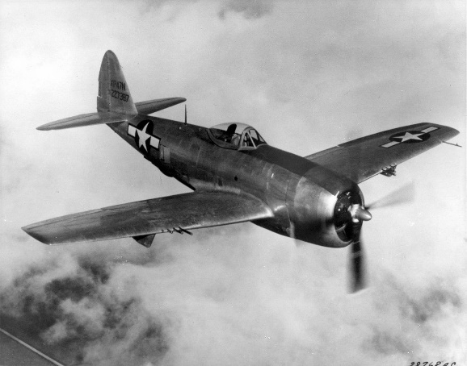
P-47 Escort Ranges

Slide 3
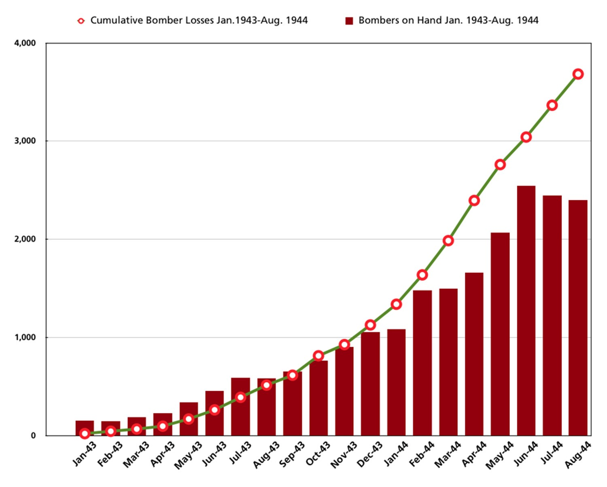
Bomber Losses

Slide 4
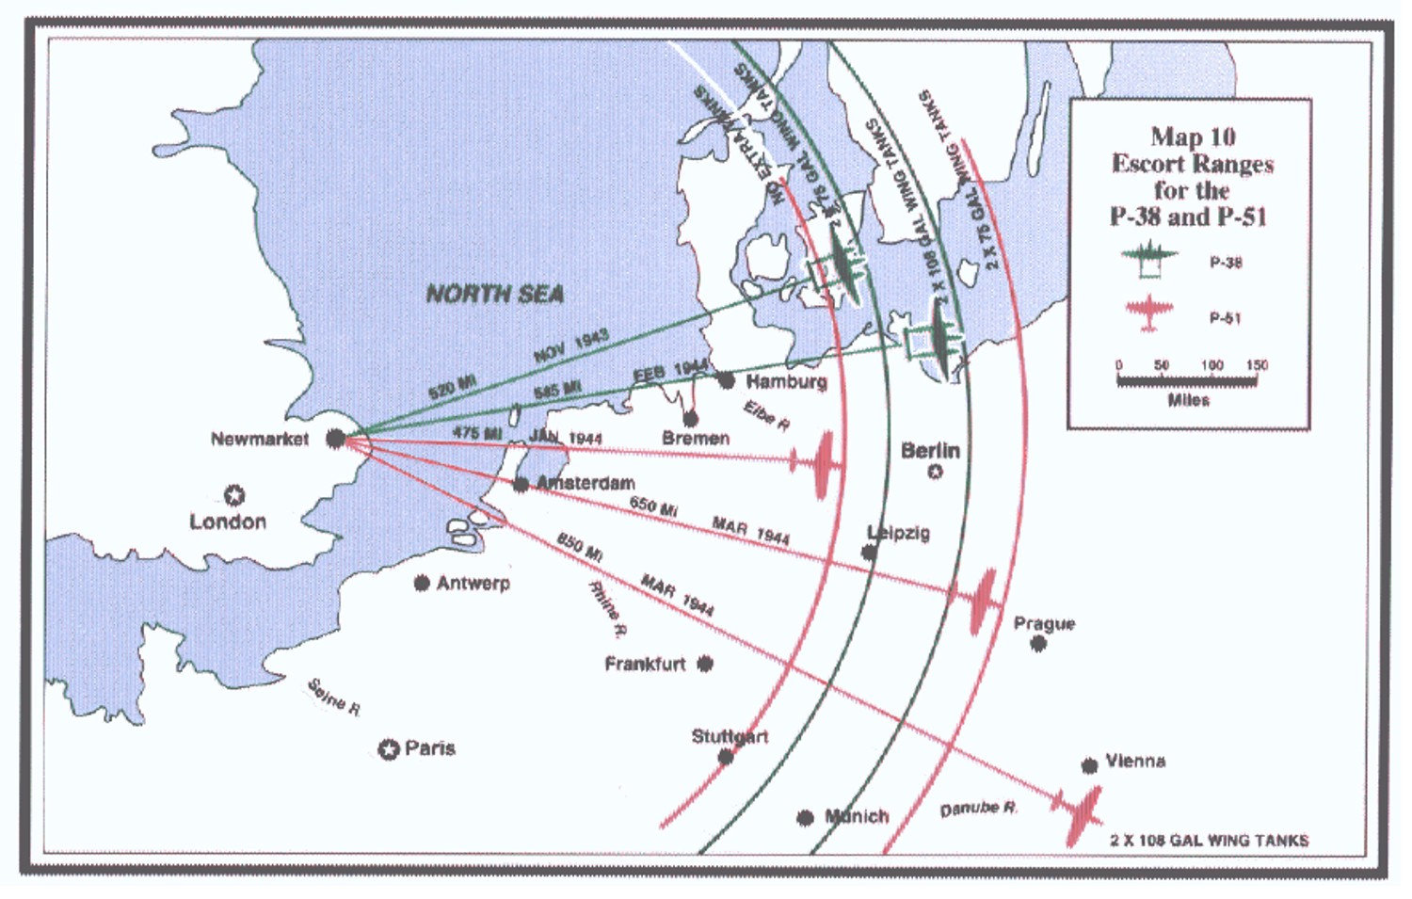
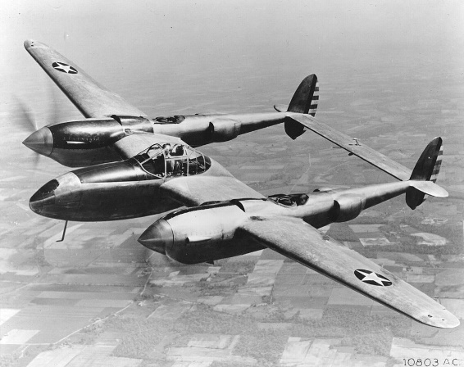
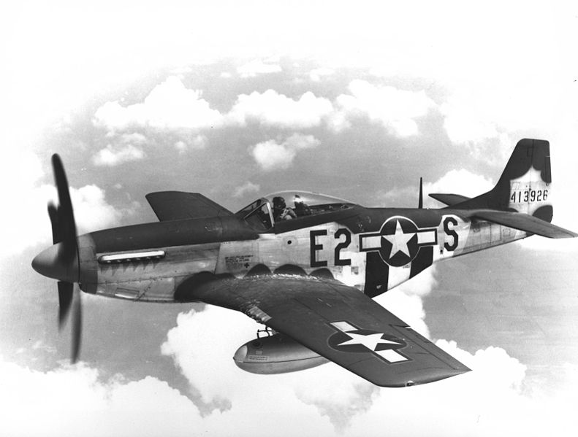
Longer Range Escorts

Slide 5
OPER 610 Lesson 14 Computational Complexity & The Ellipsoid Method
Dr Brian J. Lunday
Office: Rm 201E, Bldg 641

Slide 6
How Can We Evaluate and Compare Algorithms?
Method | Disadvantages
Empirical Analysis (Sample average) | Performance depends on programming language (and version); computer processor, RAM and speed; compiler. Time consuming and expensive. May perform differently on different classes of problems, yielding contradictory results. (link)
(Theoretical) Average-case Analysis | Analysis depends on probability distribution(s) used. Difficult to determine appropriate probability distribution(s). Requires challenging mathematics for even very simple problems.
Worst-case Analysis | Provide upper bounds on the number of steps required for any instance A “pathological” instance may dominate the analysis, but it may (almost) never be encountered in practice.
Best-case Analysis | Optimism is rarely rewarded.
Empirical analysis dominates most publications.
Worst-case analysis dominates our field.
Worst and/or best case analyses elevate the theoretical contributions of published work.

Slide 7

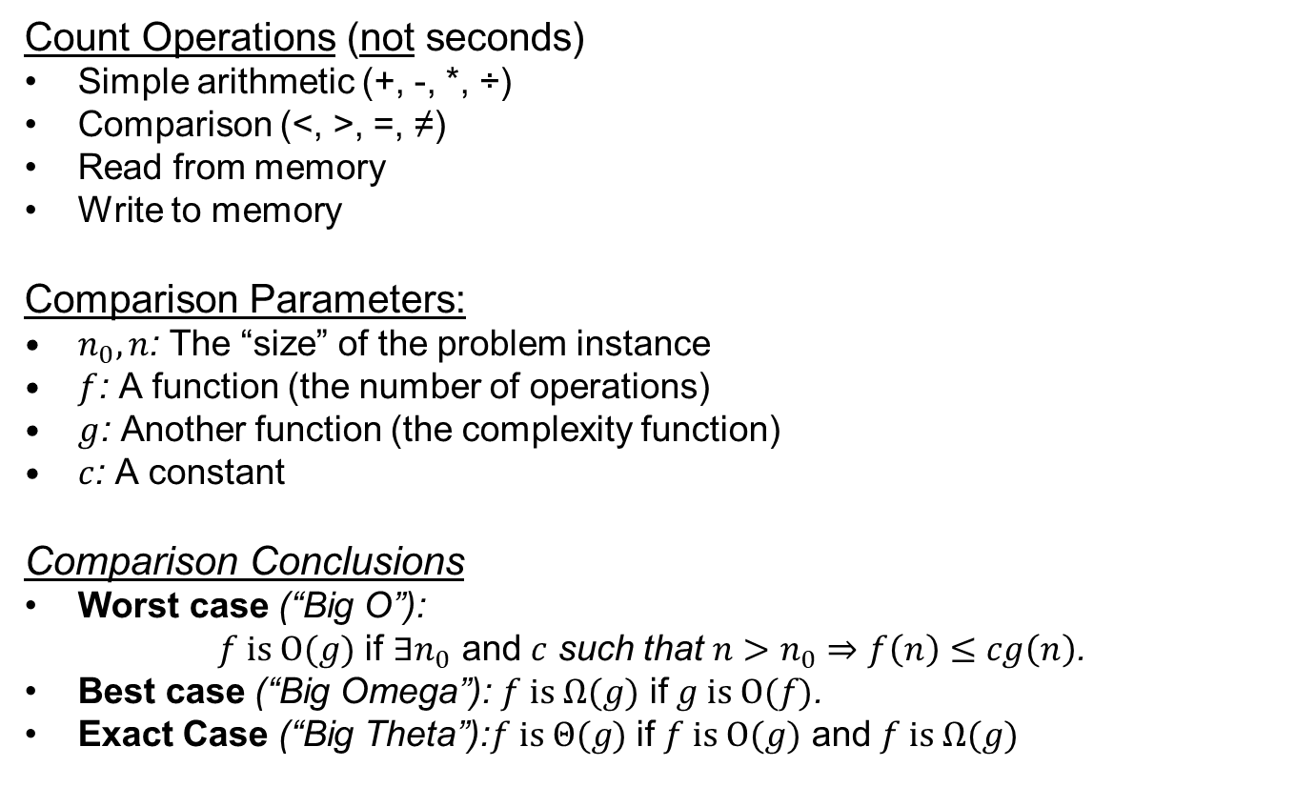
Best-/Worst-/Exact-case Complexity Analysis
Count Operations (not seconds)
Simple arithmetic (+, -, *, ÷)
Comparison (<, >, =, ≠)
Read from memory
Write to memory
Comparison Parameters:
$n_{0}, n$: The “size” of the problem instance
$f$: A function (the number of operations)
$g$: Another function (the complexity function)
$c$: A constant
Comparison Conclusions
Worst case (“Big O”):
$f is O(g)$ if ${∃n}_{0}$ and $c$ such that $n>n_{0}⇒f\left(n\right)≤cg\left(n\right)$.
Best case (“Big Omega”): $f is Ω(g)$ if $g is O(f)$.
Exact Case (“Big Theta”):$f is Θ(g)$ if $f is O(g)$ and $f is Ω(g)$
Why do we need $n_{0}$?

Slide 8
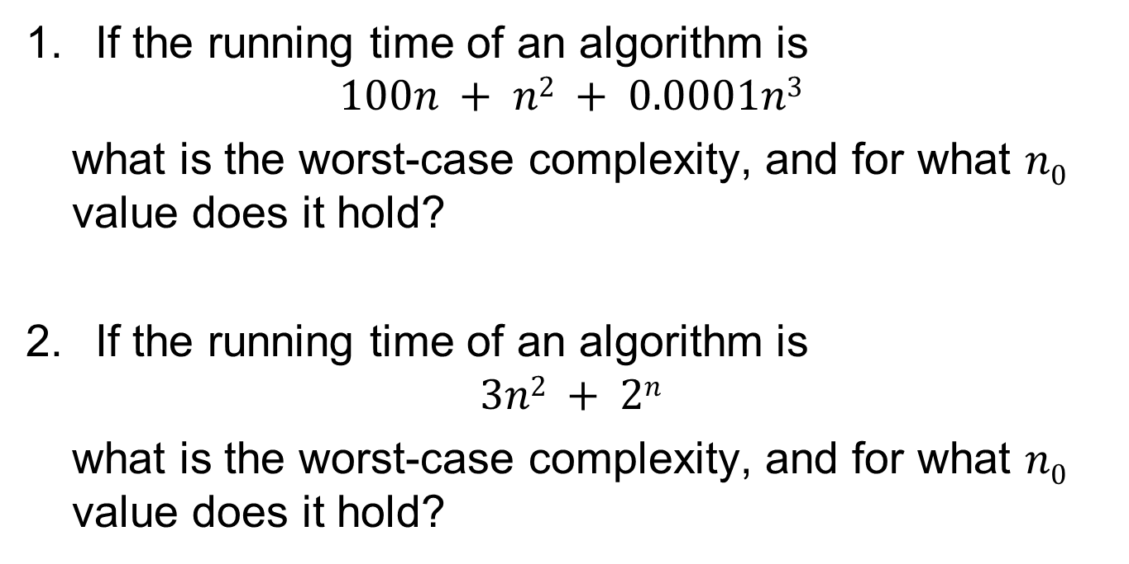
Worst-case Complexity Examples
If the running time of an algorithm is
$$100n + n2 + 0.0001n3$$
what is the worst-case complexity, and for what $n0$ value does it hold?
If the running time of an algorithm is
$$3n2 + 2n$$
what is the worst-case complexity, and for what $n0$ value does it hold?
n₀ =10,000
n₀ ≈7.33

Slide 9
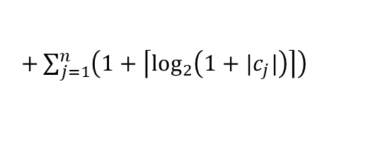




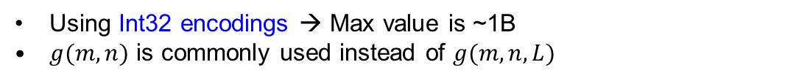




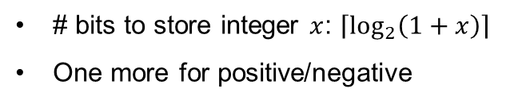

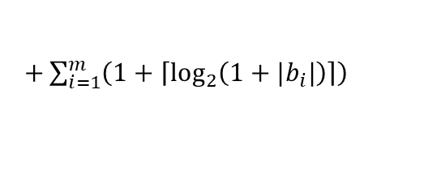

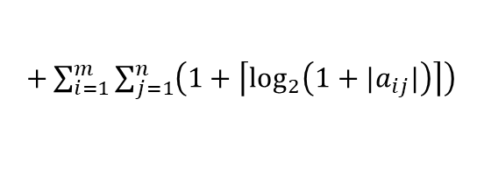

The “size” of a problem
How much memory does it take to store a constraint?
Decimal Integer | Binary Representation
1 | 1
3 | 11
4 | 100
25 | 11001
# bits to store integer $x$: $\left\lceil \log_{2}\left(1+x\right)\right\rceil$
One more for positive/negative
$$x≤1$$
$$x≤−1$$
$$11913x≤91741$$
1 bit
2 bits
31 bits
How many bits does it take to store an LP?
$L=$
$\left(1+\left\lceil \log_{2}\left(1+m\right)\right\rceil \right)$
$$32$$
Number of constraints
$$32$$
$+\left(1+\left\lceil \log_{2}\left(1+n\right)\right\rceil \right)$
Number of decision variables
$+\sum_{i=1}^{m}{\sum_{j=1}^{n}{\left(1+\left\lceil \log_{2}\left(1+|a_{ij}|\right)\right\rceil \right)}}$
$$32mn$$
Technical variable values
$+\sum_{j=1}^{n}{\left(1+\left\lceil \log_{2}\left(1+|c_{j}|\right)\right\rceil \right)}$
Cost coefficient values
$$32n$$
$$32m$$
$+\sum_{i=1}^{m}{\left(1+\left\lceil \log_{2}\left(1+|b_{i}|\right)\right\rceil \right)}$
RHS values
Using Int32 encodings → Max value is ~1B
$g(m,n)$ is commonly used instead of $g(m,n,L)$

Slide 10
Complexity Examples
Notation | Name | Example
O(1) | Constant | A+B
O(log(n)) | Logarithmic | Binary search
O(n) | Linear | Linear search
O(n²) | Quadratic | Bubble Sort
O(n^{c}) | Polynomial | Ellipsoid
O(c^{log(n)}) | Pseudo-polynomial | Knapsack
O(c^{n}) | Exponential | Simplex
Worst-case algorithmic analysis example (link)
Which is worse, O(n^{c}) or O(c^{n})?

Slide 11
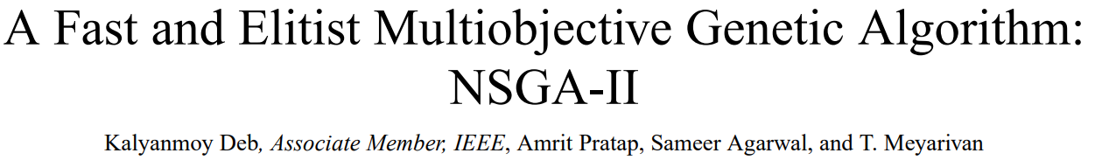
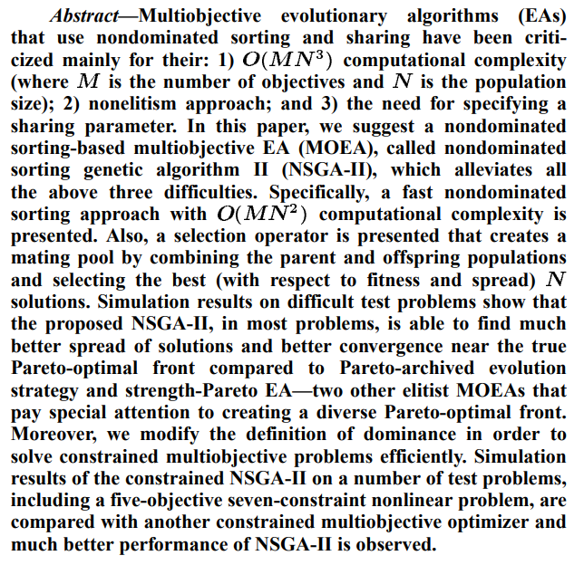

Slide 12


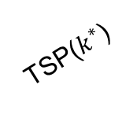
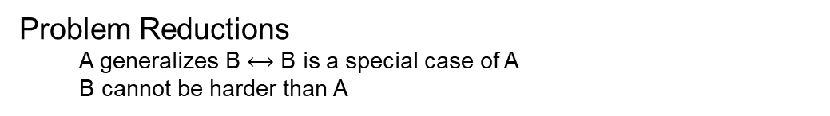
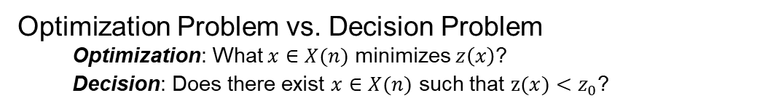

P, NP, and the Rest…
Optimization Problem vs. Decision Problem
Optimization: What $x∈X(n)$ minimizes $z\left(x\right)$?
Decision: Does there exist $x∈X(n)$ such that $z(x)<z_{0}$?
Which is easier?
If A is “easy”?
NP
Problem Reductions
A generalizes B $⟷$ B is a special case of A
B cannot be harder than A
P
If A is “hard”?
SPP
If B is “hard”?
LPs
Class P:
We can find a solution in $O(n^{c})$ time.
TSP($k^{∗}$)
Why is P $⊆$ NP?
Class NP.
We can verify the solution in $O(n^{c})$ time.
Where do you get the solution?
NP-Complete
NP-Hard
Class NP-Complete.
In NP & NP-hard
HamCycle
Vertex cover
Longest path
MILP decision
…
TSP
Class NP-Hard.
Generalizes (in poly-time) every problem NP
MILP

Slide 13
On NP…
NP = “non-deterministic polynomial-time”
Based on the non-deterministic Turing machine
Turing machine: Abstraction of a computer w/infinite memory
Non-deterministic: multiple action options from one instruction
Two phases
Phase 1: attain a solution non-deterministically
Lucky guess
Oracle
Branching copies
Phase 2: Verify it’s a solution in polynomial time

Slide 14


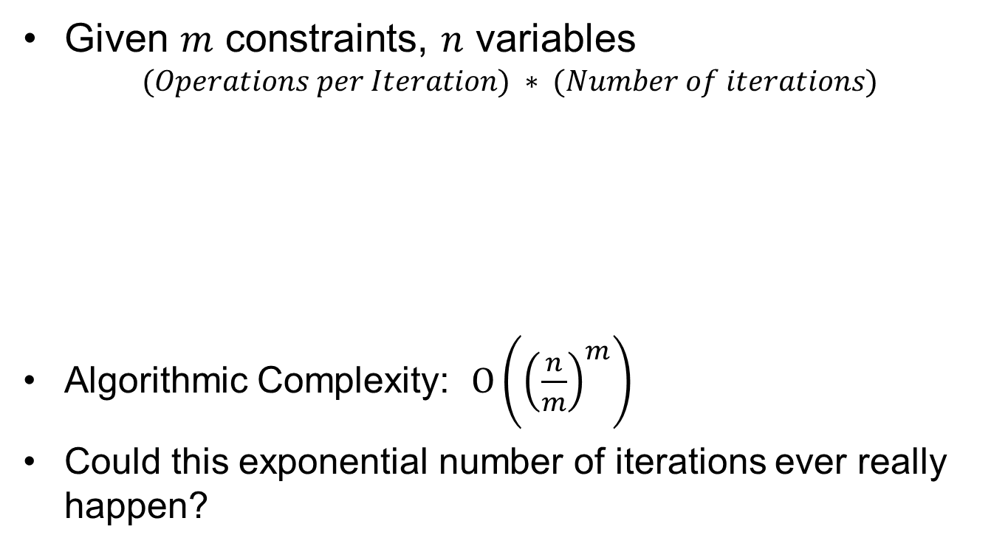
Worst-case Analysis for the Simplex Method
Given $m$ constraints, $n$ variables
$$(Operations per Iteration) ∗ (Number of iterations)$$
Algorithmic Complexity: $O\left({\left(\frac{n}{m}\right)}^{m}\right)$
Could this exponential number of iterations ever really happen?
Operation Type | Number
Multiplications | (m+1)(n-m+1)
Additions | m(n-m+1)
Total | (2m+1)(n-m+1)
Average case: $[m, 3m]$
Worst case: all vertices
$$\left(\begin{matrix}n \\ m\end{matrix}\right)=\frac{n!}{m!\left(n−m\right)!} \\ =\left(\frac{n}{m}\right)\left(\frac{n−1}{m−1}\right)\left(\frac{n−2}{m−2}\right)⋯\left(\frac{n−\left(m−1\right)}{m−\left(m−1\right)}\right) \\ >{\left(\frac{n}{m}\right)}^{m}$$
$\left(n−m\right)!$ factors out of the numerator & denominator

Slide 15
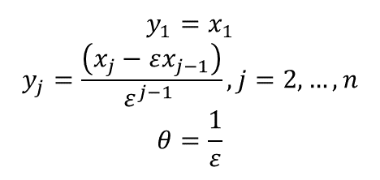
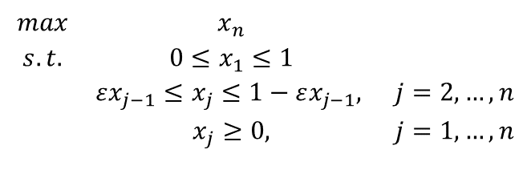
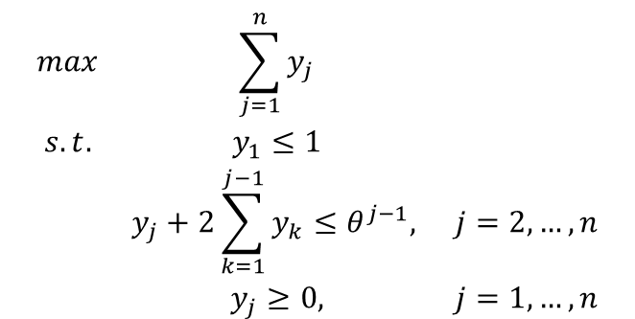
Klee-Minty Polytopes (1 of 4) Pathological Instance for the Simplex Method
$$\begin{matrix}max & x_{n} & \\ s.t. & 0≤x_{1}≤1 & \\ & εx_{j−1}≤x_{j}≤1−εx_{j−1}, & j=2,…,n \\ & x_{j}≥0, & j=1,…,n\end{matrix}$$
$$y_{1}=x_{1}$$
$$y_{j}=\frac{\left(x_{j}−εx_{j−1}\right)}{ε^{j−1} },j=2,…,n$$
$$θ=\frac{1}{ε}$$
$$\begin{matrix}max & \sum_{j=1}^{n}{y_{j}} & \\ s.t. & y_{1}≤1 & \\ & y_{j}+2\sum_{k=1}^{j−1}{y_{k}}≤θ^{j−1}, & j=2,…,n \\ & y_{j}≥0, & j=1,…,n\end{matrix}$$

Slide 16
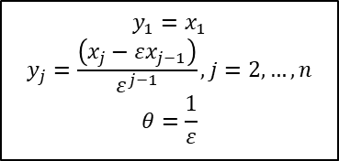
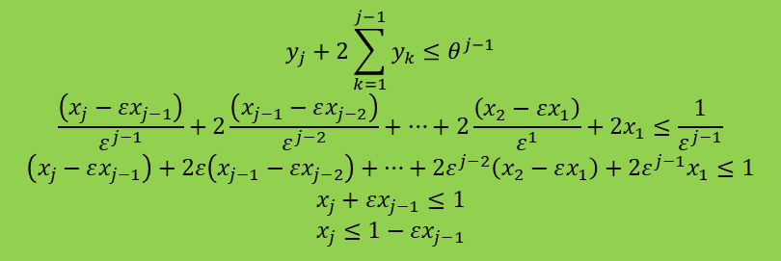
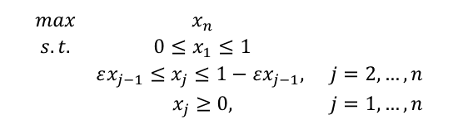
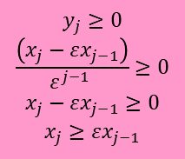
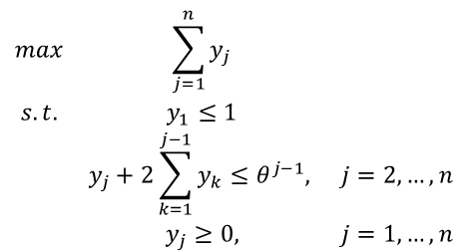

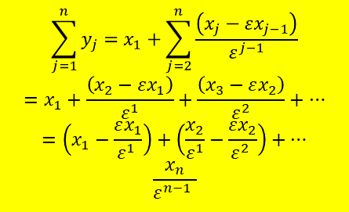
Klee-Minty Polytopes (2 of 4) Does the transformation really work?
$$\begin{matrix}max & \sum_{j=1}^{n}{y_{j}} & \\ s.t. & y_{1}≤1 & \\ & y_{j}+2\sum_{k=1}^{j−1}{y_{k}}≤θ^{j−1}, & j=2,…,n \\ & y_{j}≥0, & j=1,…,n\end{matrix}$$
$$y_{1}=x_{1}$$
$$y_{j}=\frac{\left(x_{j}−εx_{j−1}\right)}{ε^{j−1}},j=2,…,n$$
$$θ=\frac{1}{ε}$$
$$\sum_{j=1}^{n}{y_{j}}=x_{1}+\sum_{j=2}^{n}{\frac{\left(x_{j}−εx_{j−1}\right)}{ε^{j−1}}}$$
$$=x_{1}+\frac{\left(x_{2}−εx_{1}\right)}{ε^{1}}+\frac{\left(x_{3}−εx_{2}\right)}{ε^{2}}+…$$
$$=\left(x_{1}−\frac{εx_{1}}{ε^{1} }\right)+\left(\frac{x_{2}}{ε^{1}}−\frac{εx_{2}}{ε^{2} }\right)+…$$
$$\frac{x_{n}}{ε^{n−1} }$$
$$y_{j}+2\sum_{k=1}^{j−1}{y_{k}}≤θ^{j−1}$$
$$\frac{\left(x_{j}−εx_{j−1}\right)}{ε^{j−1}}+2\frac{\left(x_{j−1}−εx_{j−2}\right)}{ε^{j−2}}+…+2\frac{\left(x_{2}−εx_{1}\right)}{ε^{1}}+2x_{1}≤\frac{1}{ε^{j−1}}$$
$$\left(x_{j}−εx_{j−1}\right)+2ε\left(x_{j−1}−εx_{j−2}\right)+…+2ε^{j−2}\left(x_{2}−εx_{1}\right)+2ε^{j−1}x_{1}≤1$$
$$x_{j}+εx_{j−1}≤1$$
$$x_{j}≤1−εx_{j−1}$$
$$y_{1}=x_{1}$$
$$y_{j}≥0$$
$$\frac{\left(x_{j}−εx_{j−1}\right)}{ε^{j−1} }≥0$$
$$x_{j}−εx_{j−1}≥0$$
$$x_{j}≥εx_{j−1}$$
$$\begin{matrix}max & x_{n} & \\ s.t. & 0≤x_{1}≤1 & \\ & εx_{j−1}≤x_{j}≤1−εx_{j−1}, & j=2,…,n \\ & x_{j}≥0, & j=1,…,n\end{matrix}$$

Slide 17
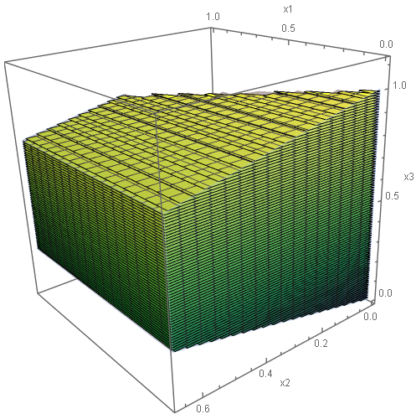
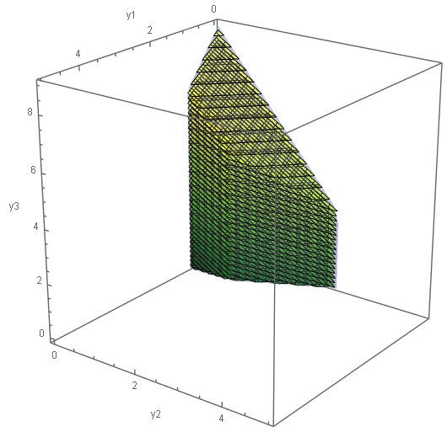
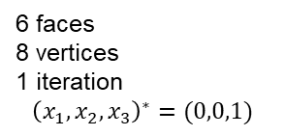
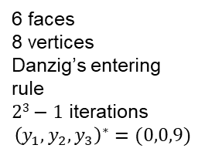
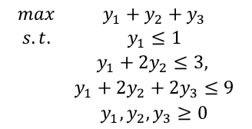
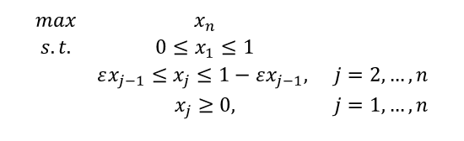
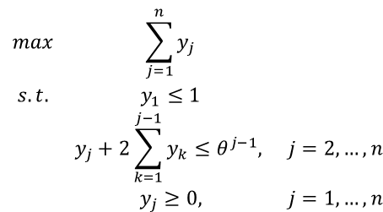
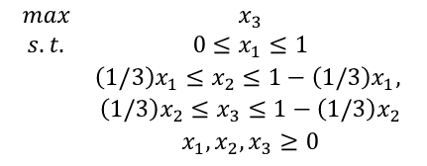

Klee-Minty Polytopes (3 of 4) Why make the transformation?
$$\begin{matrix}max & \sum_{j=1}^{n}{y_{j}} & \\ s.t. & y_{1}≤1 & \\ & y_{j}+2\sum_{k=1}^{j−1}{y_{k}}≤θ^{j−1}, & j=2,…,n \\ & y_{j}≥0, & j=1,…,n\end{matrix}$$
$$\begin{matrix}max & x_{n} & \\ s.t. & 0≤x_{1}≤1 & \\ & εx_{j−1}≤x_{j}≤1−εx_{j−1}, & j=2,…,n \\ & x_{j}≥0, & j=1,…,n\end{matrix}$$
$$n=3$$
$$ε=1/3$$
$$\begin{matrix}max & x_{3} \\ s.t. & 0≤x_{1}≤1 \\ & \left(1/3\right)x_{1}≤x_{2}≤1−\left(1/3\right)x_{1}, \\ & \left(1/3\right)x_{2}≤x_{3}≤1−\left(1/3\right)x_{2} \\ & x_{1},x_{2},x_{3}≥0\end{matrix}$$
$$\begin{matrix}max & y_{1}+y_{2}+y_{3} \\ s.t. & y_{1}≤1 \\ & y_{1}+2y_{2}≤3, \\ & y_{1}+2y_{2}+2y_{3}≤9 \\ & y_{1},y_{2},y_{3}≥0\end{matrix}$$
6 faces
8 vertices
1 iteration
$${\left(x_{1},x_{2},x_{3}\right)}^{∗}=(0,0,1)$$
6 faces
8 vertices
Danzig’s entering rule
$23−1$ iterations
$${\left(y_{1},y_{2},y_{3}\right)}^{∗}=(0,0,9)$$
Pathological Instance!

Slide 18

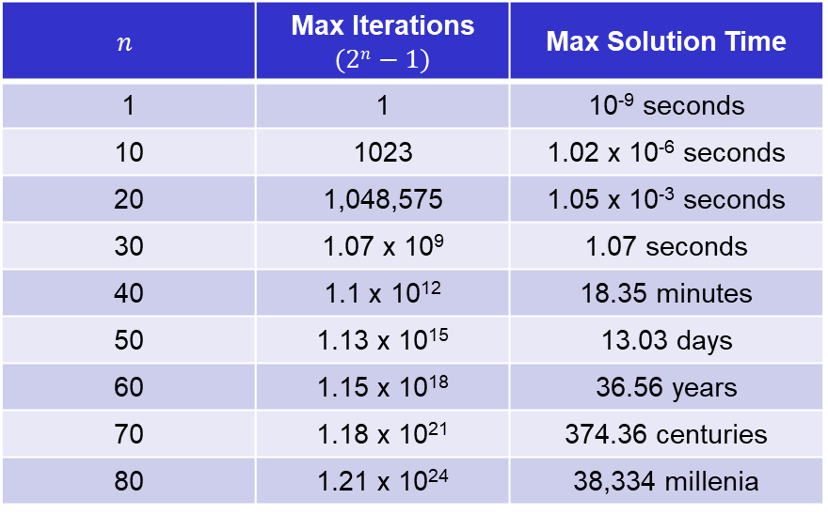
Klee-Minty Polytopes (4 of 4) Impact of Possible Exponential Effort
Assuming ${10}^{−9}$ seconds per iteration (less than described in the text) and a worst-case algorithmic result of $O(2n)$
We need a polynomial time algorithm to solve LPs, and the Simplex Method isn’t it!
$$n$$ | Max Iterations $$(2n−1)$$ | Max Solution Time
1 | 1 | 10⁻⁹ seconds
10 | 1023 | 1.02 x 10⁻⁶ seconds
20 | 1,048,575 | 1.05 x 10⁻³ seconds
30 | 1.07 x 10⁹ | 1.07 seconds
40 | 1.1 x 10¹² | 18.35 minutes
50 | 1.13 x 10¹⁵ | 13.03 days
60 | 1.15 x 10¹⁸ | 36.56 years
70 | 1.18 x 10²¹ | 374.36 centuries
80 | 1.21 x 10²⁴ | 38,334 millenia

Slide 19
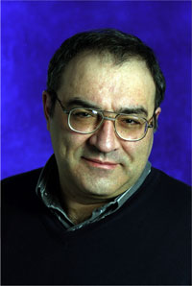
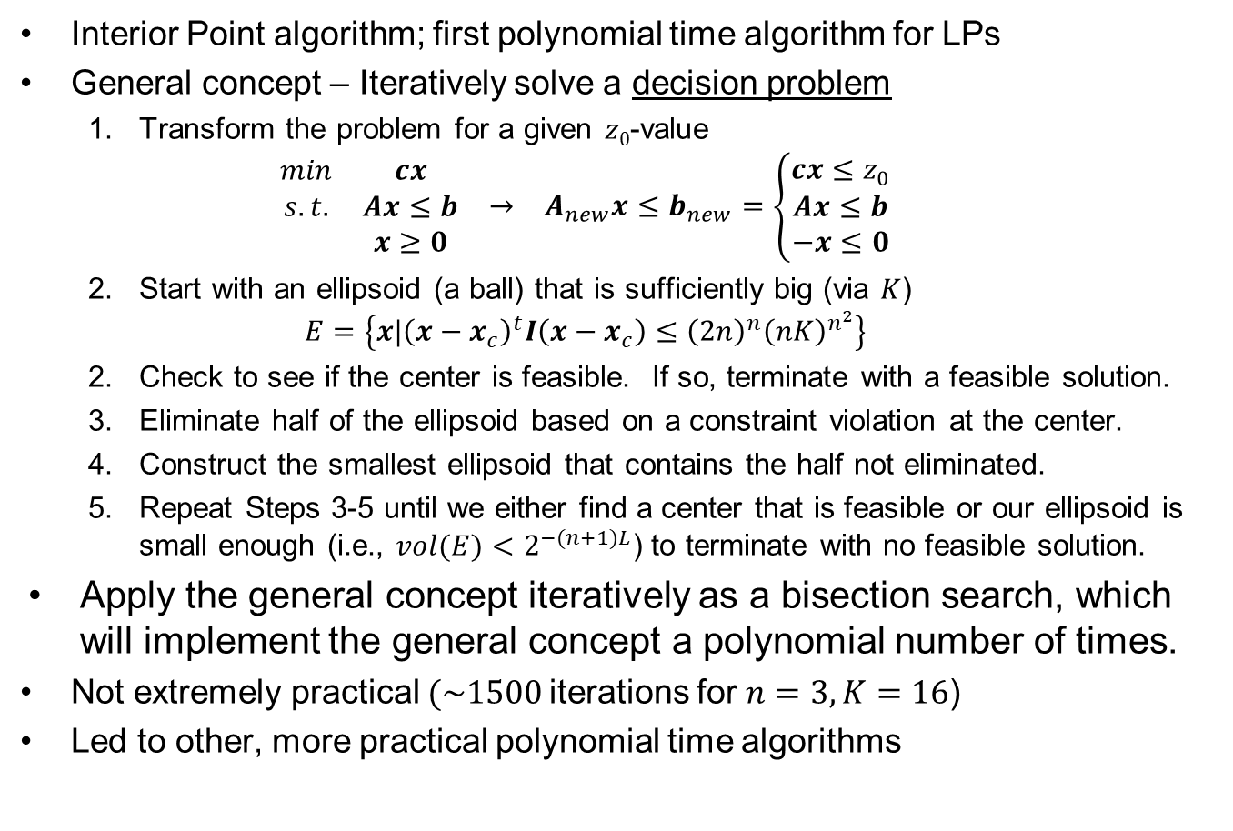
Khachian’s Ellipsoid Algorithm (1 of 2)
Interior Point algorithm; first polynomial time algorithm for LPs
General concept – Iteratively solve a decision problem
Transform the problem for a given $z0$-value
$$\begin{matrix}\begin{matrix}min & cx \\ s.t. & Ax≤b \\ & x≥0\end{matrix} & → & A_{new}x≤b_{new}=\left\{\begin{matrix}cx≤z_{0} \\ Ax≤b \\ −x≤0\end{matrix}\right.\end{matrix}$$
Start with an ellipsoid (a ball) that is sufficiently big (via $K$)
$$E=\left\{x|{\left(x−x_{c}\right)}^{t}I\left(x−x_{c}\right)≤{\left(2n\right)}^{n}{\left(nK\right)}^{n^{2}}\right\}$$
Check to see if the center is feasible. If so, terminate with a feasible solution.
Eliminate half of the ellipsoid based on a constraint violation at the center.
Construct the smallest ellipsoid that contains the half not eliminated.
Repeat Steps 3-5 until we either find a center that is feasible or our ellipsoid is small enough (i.e., $vol(E)<2^{−(n+1)L}$) to terminate with no feasible solution.
Apply the general concept iteratively as a bisection search, which will implement the general concept a polynomial number of times.
Not extremely practical $(\sim 1500$iterations for $n=3, K=16$)
Led to other, more practical polynomial time algorithms
1952 – 2005
Notes:
Leonid Genrikhovich Khachiyan (May 3, 1952 – April 29, 2005) was a Soviet mathematician of Armenian descent who taught Computer Science at Rutgers University. He was most famous for his Ellipsoid algorithm (1979) for linear programming, which was the first such algorithm known to have a polynomial running time. Even though this algorithm was shown to be impractical due to the high degree of the polynomial in its running time, it has inspired other randomized algorithms for convex programming and is considered a significant theoretical breakthrough.
Khachiyan was born in St. Petersburg and moved to Moscow with his parents at age 9. There he later earned a Ph.D. in computational mathematics in 1978 and a D.Sc. in computer science in 1984, both from the Computing Center of the USSR Academy of Sciences. In 1982 he won the prestigious Fulkerson Prize from the Mathematical Programming Society and the American Mathematical Society for outstanding papers in the area of discrete mathematics.
Prior to moving to the United States in 1989, Khachiyan held a series of research and teaching positions at the Computing Center of the USSR Academy of Sciences and the Moscow Institute of Physics and Technology. In 1989 he joined Cornell University’s School of Operations Research and Industrial Engineering as a visiting professor and had been at Rutgers since 1990.
After moving to the United States, Khachiyan's work continued some of its old ideas, as he worked on the complexity of maximal volume inscribed ellipsoids and wrote a paper on rounding polytopes, adding some new ones. He wrote a series of papers with Bahman Kalantari on various matrix scaling and balancing problems.
Khachiyan is survived by his wife of 20 years and two daughters who currently live in the United States. He is also survived by his father, a retired professor of theoretical mechanics, his mother, a retired civil engineer, and two brothers, all of whom live in Moscow.

Slide 20

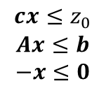



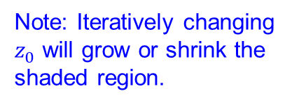
Khachian’s Ellipsoid Algorithm Notional Implementation
$$\begin{matrix}cx≤z_{0} \\ Ax≤b \\ −x≤0\end{matrix}$$
$$x2$$
$$x2$$
$$x2$$
$$x1$$
$$x1$$
$$x1$$
$$x2$$
$$x2$$
Note: Iteratively changing $z_{0}$ will grow or shrink the shaded region.
$$x1$$
$$x1$$

Slide 21
Questions & Discussion

Slide 22
For Next Class
Section 8.4 (pp 402-414): Karmarkar’s Algorithm.
Identify the underlying assumptions
Validate the transform and inverse transform mechanisms
Seek to understand what Figures 8.2-8.6 demonstrate
Look for convergence and complexity (pg. 409)
Follow the example (pp. 410-414) for algorithmic implementation
Optimal Rounding Routine
Discussed on pp. 410 & 408 as a “purification scheme”
What’s it doing? How is it doing it?
Homework #11: Problem 6.27
Note the text errata

